Slide 1
Chapter 4
The Laws of Motion
Gravity

Slide 2
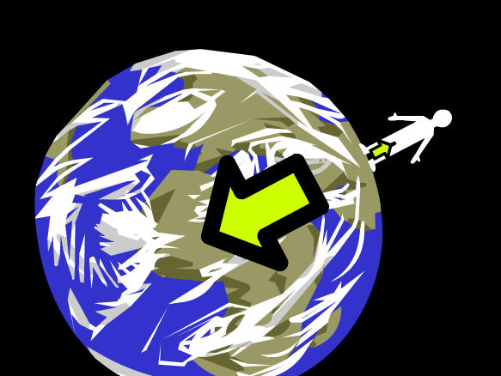
Gravity
There’s a lot about you that’s attractive!
At this very moment, you are exerting an attractive force on everything around you
Your desk, your classmates, even planets millions of kilometers away!
Anything that has mass is attracted by the force of gravity

Slide 3
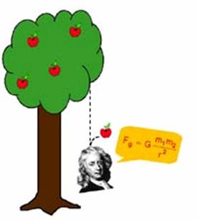
Gravity
Gravity is an attractive force between any two objects that depends on the mass of the objects and the distance between them
This force increases as the mass of either object increases or as the objects move closer

Slide 4
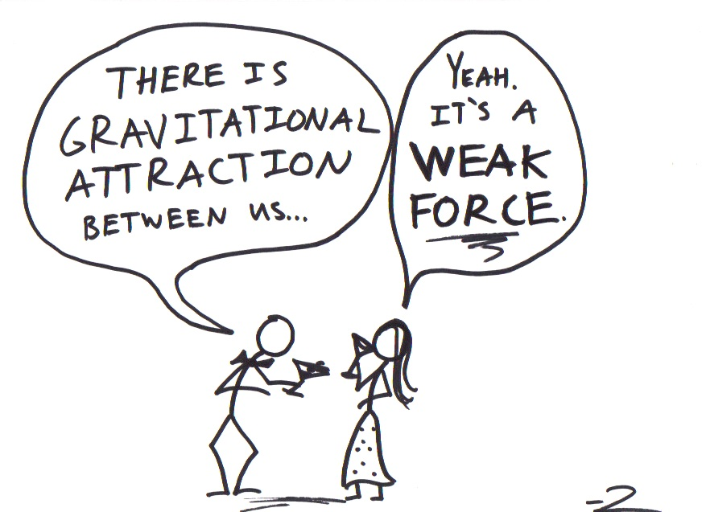
Gravity
Newton’s Law of Universal Gravitation
States that the force of attraction between two objects results from their masses and the distance between the two objects
All objects are attracted to one another

Slide 5
Gravity

Slide 6
Gravity
Mass has a lot to do with gravity, but so does acceleration
If you dropped a bowling ball and a marble at the same time, which would hit the ground first, assuming air resistance and all factors other than gravity are ignored?
They would hit the ground at the same time because they have the same acceleration
Close to Earth, the acceleration of an object in free fall is 9.8 m/s² (REMEMBER THIS NUMBER!) and is symbolized by the letter g

Slide 7
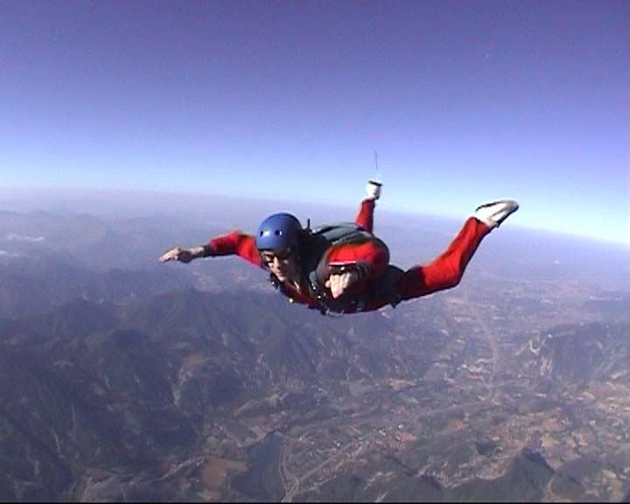
Gravity
To figure out the gravitational force
GF = mass (kg) x 9.8 m/s²
Units = Newtons (N)
This is actually the same formula you use to calculate weight
Weight is the mass of an object with gravity taken into consideration
Even if you are not falling from the sky, Earth’s gravity still has a downward pull on you
Mass is how much matter there is, weight is a force
A skydiver with a mass of 70 kg accelerates to earth at a rate of 9.8 m/s². What is the force of gravity on the skydiver?

Slide 8
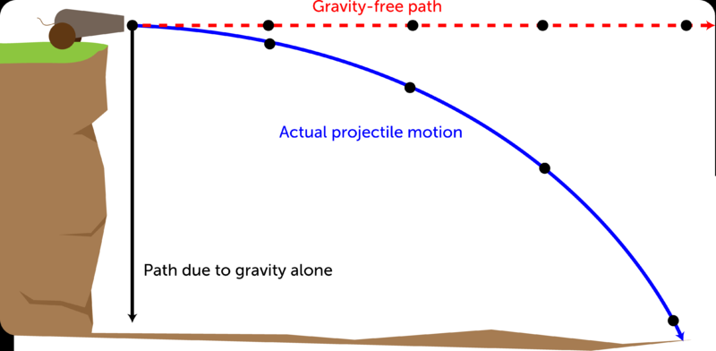
Gravity
Gravity influences your ability to throw a ball in a straight line
Typically the object you’re throwing (aka a projectile) curves downward
When you throw an object, the force exerted by your hand pushes the object forward, which gives the ball a horizontal motion
When you let go of the object, gravity can accelerate it downward, giving it a vertical motion
This combination of motions is unbalanced, causing the object to travel in a curve

Slide 9
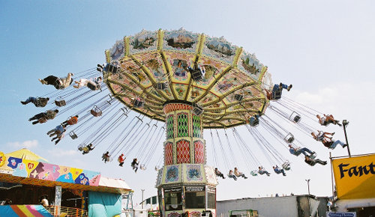
Gravity
Another type of motion we see that results from gravity is centripetal
Centripetal means “toward the center” or “center seeking”
Centripetal force is a net force that directs an object to follow a circular or curved path
Gravity is pushing/pulling the object towards the center of the path
Centripetal force keeps the riders on these swings moving in a circle

